Slide 1
Applied Analytics in Biodiversity
Yvette Yi Yuan
Introduction to Data Analysis Capstone @ CodeAcademy

Slide 2
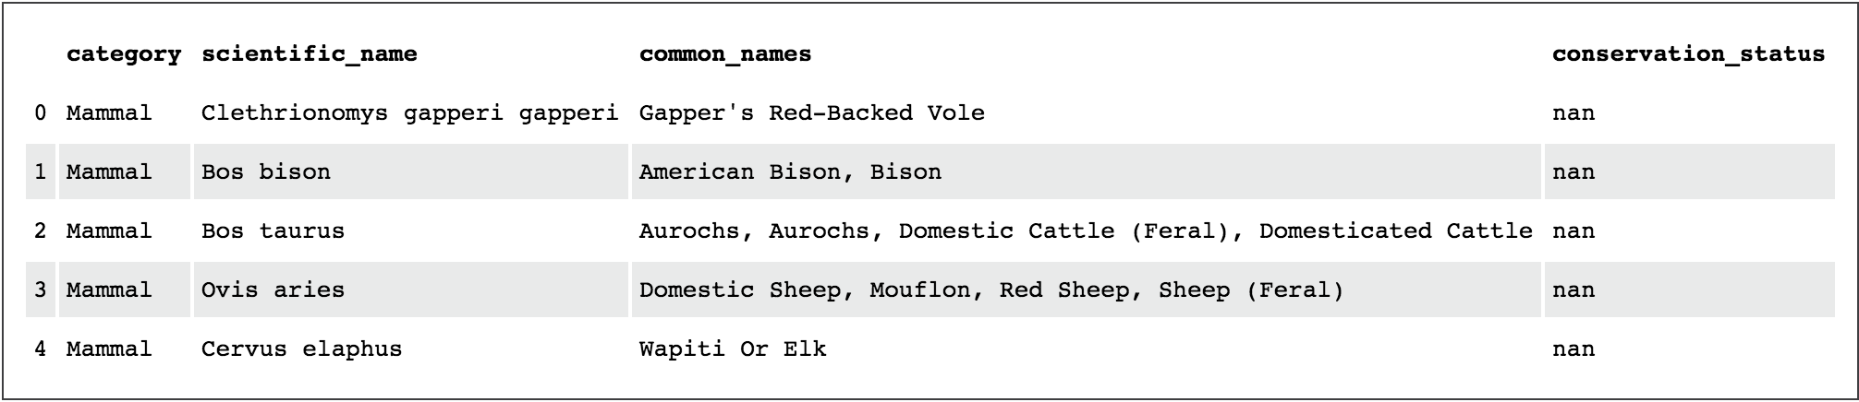
Protected Species – examining species.csv
The species_info.csv is a Data Frame that contains the following objects
The scientific name of each species
The common names of each species
The species conservation status

Slide 3
Protected Species - examining species.csv
How many different species are in the species DataFrame?
5541
What are the different values of category in the DataFrame species?
'Mammal' 'Bird' 'Reptile' 'Amphibian' 'Fish' 'Vascular Plant' 'Nonvascular Plant'
What are the different values of conservation_status?
nan 'Species of Concern' 'Endangered' 'Threatened' 'In Recovery'

Slide 4
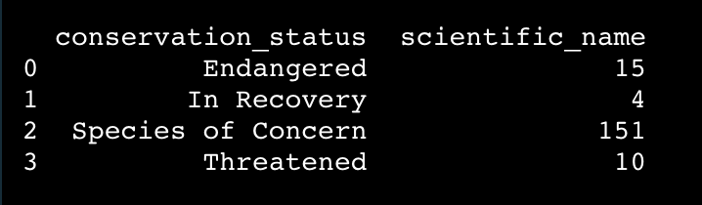
Protected Species – examining conservation_status
How many of each species fall into these conservation statuses?
It seems like only a small number of them are categorized as needing some sort of protection!

Slide 5
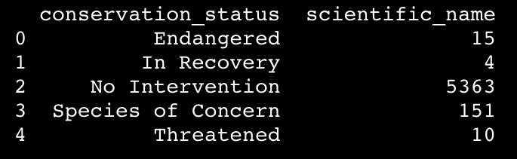
Protected Species - examining conservation_status
Recall that conservation_status also has the object NaN. Let’s now include the null values (now ‘No Intervention’) to get an accurate representation of the species conservation status.

Slide 6
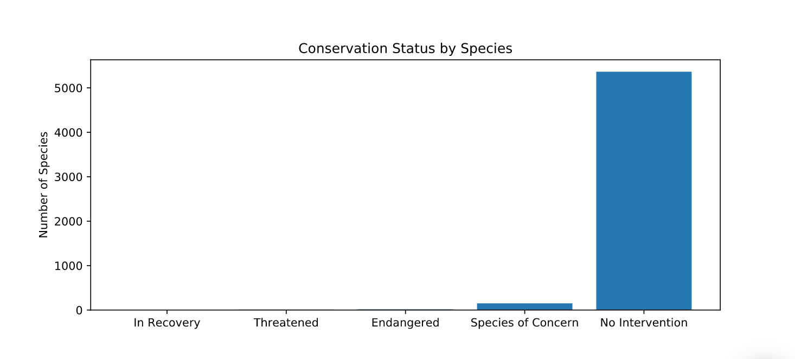
Protected Species - examining conservation_status
Now it would be helpful to visualize this data, best in a bar chart

Slide 7
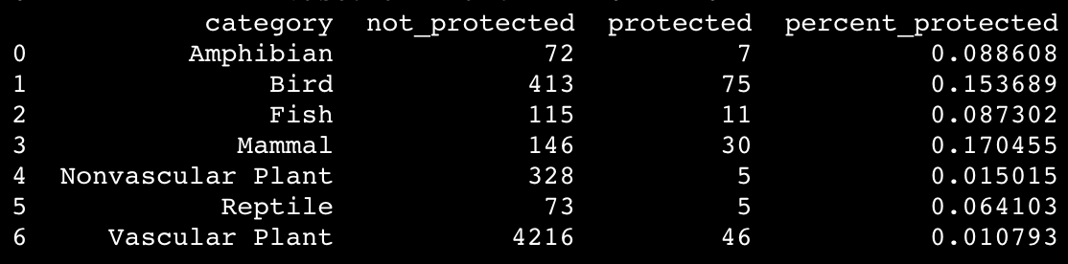
Protected Species - Are certain types of species more likely to be endangered?
It would be helpful to represent how many of each species are being protected or not, further adding the percent of the species that is being protected (which is equal to protected divided by the total number of species).
It seems like mammals and birds are the most and the second most endangered species compared to the others!

Slide 8
Protected Species – YES! certain types of species are more likely to be endangered
It looks like Mammals are more likely to be endangered than Birds, but is it a significant difference? Because there are two sets of categorical data, we can run a chi-squared test to see if this statement is true.
In this test, our null hypothesis is that this difference is due to chance.
As a result, we find pval = 0.687594809666 > 0.05, therefore there is no significant difference.
It looks like this difference isn't significant!
Running the same test between Reptiles and Mammals…
pval =0.0383555902297 < 0.05
Now there is significant difference!
Therefore, we can conclude that certain types of species are more likely to be endangered than others!

Slide 9
Protected Species - Recommendations
Based on your significance calculations, mammals and birds in particular demonstrate an urgency to be protected; we advise that effective and swift measures be taken to address, at least, the condition of those two species.

Slide 10
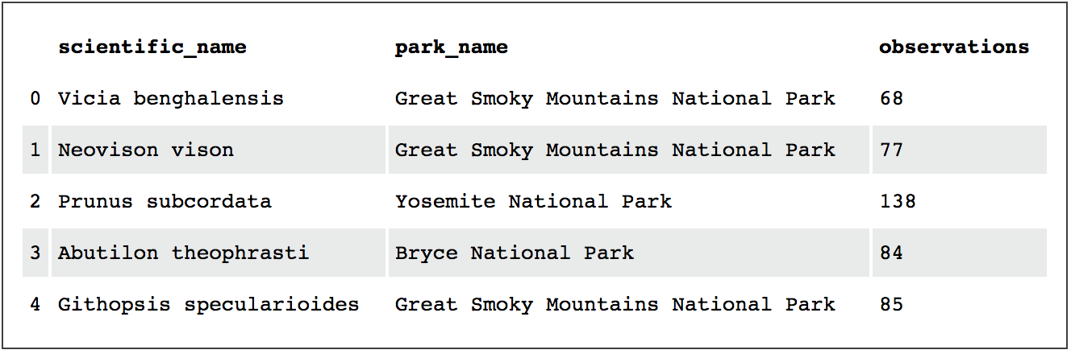
Observation- examining observations.csv
The observations.csv is a Data Frame that contains the following objects
Scientific name of each species
Park name where the animal was observed
Sum of observations of the species

Slide 11
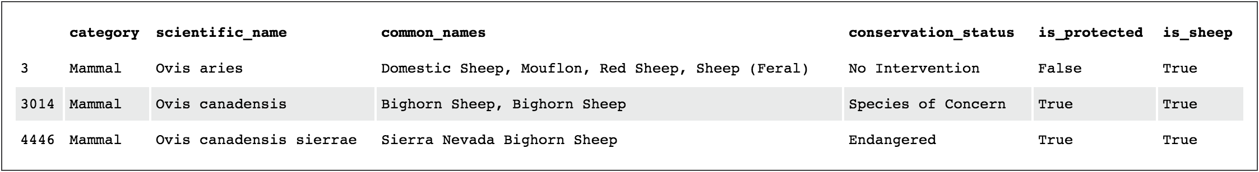
Observation- tracking sheep
Scientists express an interest in tracking sheep, so let’s first look for any names that refer to sheep

Slide 12
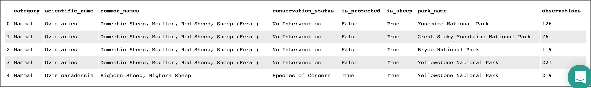
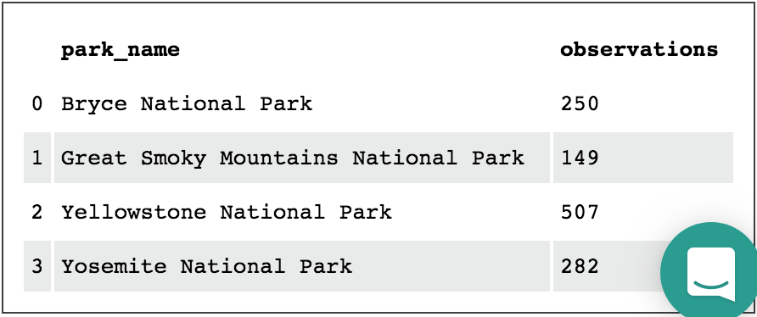
Observation-tracking sheep
We have determined what species in species are sheep, now we need to determine where these sheep are locating
If we want know how many total sheep sightings were made at each national park

Slide 13
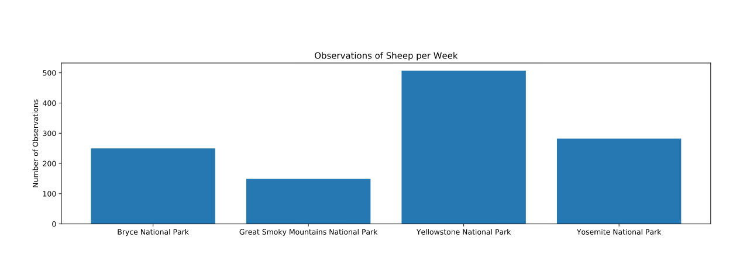
Observation-tracking sheep
Now it would be helpful to visualize this data, again, best in a bar chart

Slide 14
Observation- Reducing Foot and Mouth
Scientists have been running a program to reduce the rate of foot and mouth disease at that park.
They want to test whether or not this program is working.
They want to be able to detect reductions of at least 5 percentage points.
The only information that the scientists currently have is that last year it was recorded that 15% of sheep at Bryce National Park have foot and mouth disease.
Let’s calculate the number of sheep that scientists would need to observe from each park to make sure their foot and mouth percentages are significant.
We are using the default level of significance 90%.

Slide 15
Observation- Reducing Foot and Mouth
Because we will need to detect reductions of at least 5 percentage points, the minimum detectable effect would be 5/15 * 100% which is aroung 33.3%

Slide 16
Observation- Reducing Foot and Mouth
How many weeks would the scientists need to spend at Yellowstone National Park to observe enough sheep?
870/507 which is the sample size for scientists to be sure that a >5% drop in observed cases of foot and mouth disease in the sheep at Yellowstone was significant, divided by the number of sheep observed in Yellowstone per week, we get 1.72 weeks
The scientists also want to repeat their measurements at Bryce National Park.
870/250 which is the number of sheep observed in Bryce National Park per week, we get 3.48 weeks

